Slide 1
CPU
Performs calculations
Consists of electronic circuits
Components:
Control Unit
Arithmetic Logic Unit (ALU)
Floating Point Unit
Caches and Registers

Slide 2
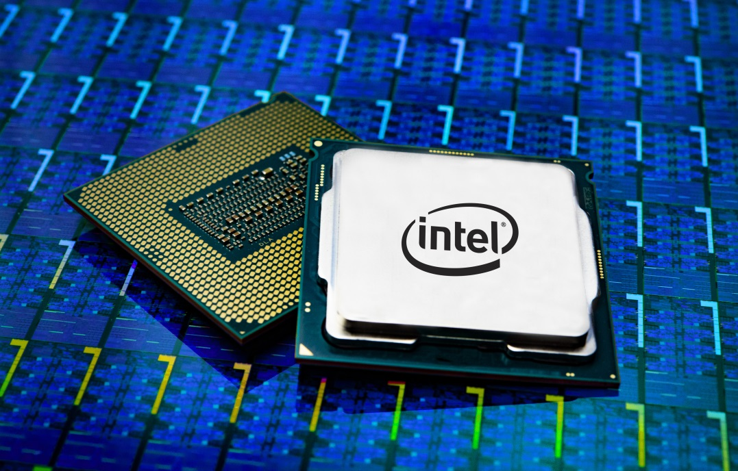
Examples
Intel® Core™ i3 8100
4x 3,60 GHz
129€
Intel® Core™ i7 9700K
8x 3,60 GHz
409€

Slide 3
Assembling
Discharge yourself
Work on a non-metallic surface
Put CPU in position
Install heat sink using cooling paste
Stick to manual

Slide 4
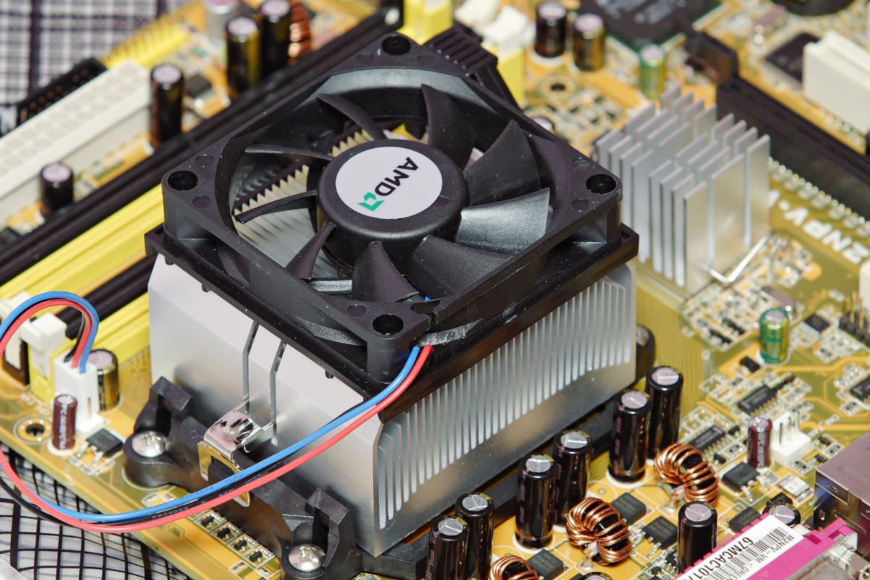
Assembling

Slide 5
RAM
Random Access Memory
Consists of integrated circuits
Stores data and running programs

Slide 6
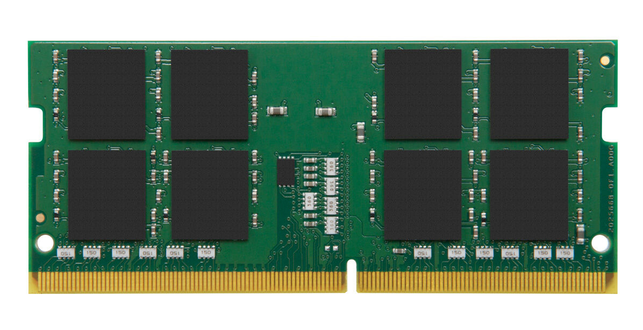
Examples
Kingston ValueRAM
4GB DDR3L-1600
23€
Kingston ValueRAM
16GB DDR4-2400
90€

Slide 7
Assembling
Just put the RAM in the appropriate slot

